Slide 1
FoodLink: A Collaborative Platform for Food Rescue and Redistribution
INFO 5100 Final Project Presentation
Northeastern University – Spring 2025
Team Members: Yige Wang
Yue Wu
Zhiyu Sun

Slide 2
01
Problem Statement

Slide 3
Problem Statement
Problem:
Food waste remains a serious urban issue, while many homeless individuals lack access to daily meals.
Our Goal:
To build a collaborative platform where food can be rescued from donation sources and efficiently redistributed to those in need through multi-organization and multi-enterprise coordination.
Why Now?
Massive food waste from suppliers
Lack of coordination between donors, inspectors, and shelters
Manual and inefficient distribution

Slide 4
02
Roles

Slide 5
Enterprise | Key Roles Involved | Responsibilities
Food Enterprise | Food Donor | Donates food items
FreshCheck Enterprise | NewFoodChecker, PostFoodChecker | Inspects donated food (initial and periodic)
volunteer Enterprise | Task Manager, Driver | Assigns drivers and completes deliveries
RescueNet Enterprise | Homeless, Shelter Helper | Submits food requests and manages homeless users

Slide 6
03
Key Use-Cases

Slide 7
Food Donation Flow
FoodEmployee submits Push Food Request → FreshChecker conducts initial inspection → PostChecker performs periodic re-inspection → Validated food appears in Push Food List → Shelter Helper can view available food for selection

Slide 8
Food Request Submission Flow
Homeless User → submits Food Request via UI → RequestCollectOrg receives and stores the request → Request status set to Pending

Slide 9
Cross-Organization Task Assignment Flow
Shelter Helper → selects suitable food items → creates Food Delivery Request → Task Manager receives the request → assigns Driver for delivery → Driver completes task and updates status to Delivered

Slide 10
User Registration Flow
Register ShelterHelper & Homeless & Drivers & TaskManager & FoodEmployee
Enterprise hierarchy admin & Organization hierarchy admin

Slide 11
04
System Architecture Overview

Slide 12
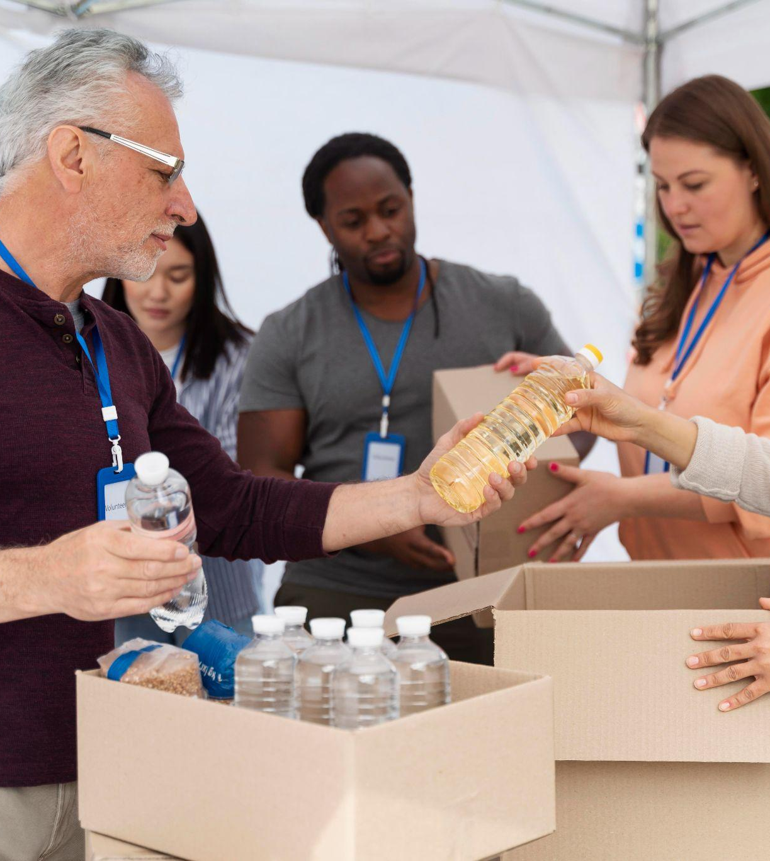
System Architecture Overview
Component Breakdown:
Network: Connects all enterprises and organizations
Enterprises: Each manages its own domain (donation, inspection, logistics, shelters, requests)
Organizations: Specialized sub-units executing work
WorkRequest: Cross-enterprise communication backbone

Slide 13
05
Implementation Techniques

Slide 14
Implementation Techniques
Java Swing GUI for all user interfaces
Role-Based Login for Admin, Shelter Helper, Driver, Homeless
Request Processing System: cross-enterprise food request handling
Work Queues: Track food request and delivery status
Status Management: Pending, Approved, Delivered
Faker Library: Used to auto-generate sample homeless data

Slide 15
06
Authentication & Validation

Slide 16
Authentication & Validation
Login System: Email and password per role
Validation Rules:
Email format, username uniqueness
Non-empty fields, valid phone number
Password Security: Enforced during registration
System Admin Panel: Full CRUD access to all users and orgs

Slide 17
07
Why Every Enterprise Matters

Slide 18
Why Every Enterprise Matters
Food Enterprise: Without food, the system fails. The origin of the entire value chain.
FreshCheck Enterprise: Ensures safety and trust. No unsafe food reaches users.
volunteer Enterprise : Bridges the gap between food and people. Logistics = action.
RescueNet Enterprise: Initiates the help process by matching requests to food. Entry point for the homeless. Handles user needs and tracks outcomes.
Without any one of these, the platform loses its full value.

Slide 19
08
Advanced Features

Slide 20
Advanced Features
Dynamic ComboBoxes based on registered organizations
Real-time food request updates for users
Cross-role workflows: from request to delivery
Clean UI with role-specific dashboards
Config module with Faker-generated sample data

Slide 21
08
Definition of the Problem We Solved

Slide 22
Definition of the Problem We Solved
During the development phase, we encountered a critical issue when working collaboratively on different operating systems (Mac and Windows).
After performing a Git merge across platforms, the program failed to launch or render the UI correctly on some machines.
Initially, we suspected platform compatibility issues, as the application behaved inconsistently between Windows (faster) and macOS (lagging or non-functional). We spent time comparing both environments and debugging UI behaviors.

Slide 23
Definition of the Problem We Solved
Root Cause Identified:
The actual issue was not OS-specific but rather related to Java Swing UI not updating after a component switch in our main container (CardLayout). The UI changes were not visually reflected after navigating between panels.
Solution Implemented:
We resolved the issue by explicitly adding the following two statements in the main container switch logic:
container.revalidate();
container.repaint();

Slide 24
Definition of the Problem We Solved
These two calls force the Swing container to refresh its layout and repaint the components, ensuring UI transitions function correctly on all platforms.
Key Takeaway:
This problem highlighted the importance of platform-agnostic UI handling and the need for explicit layout refresh in Java Swing development, especially in multi-developer, cross-platform projects.

Slide 25

Thank you for your attention!
We're happy to demonstrate the system now.

